Slide 1
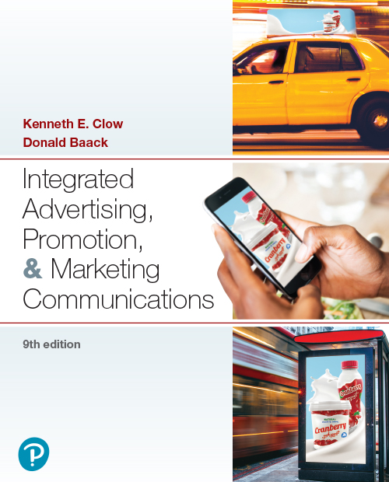
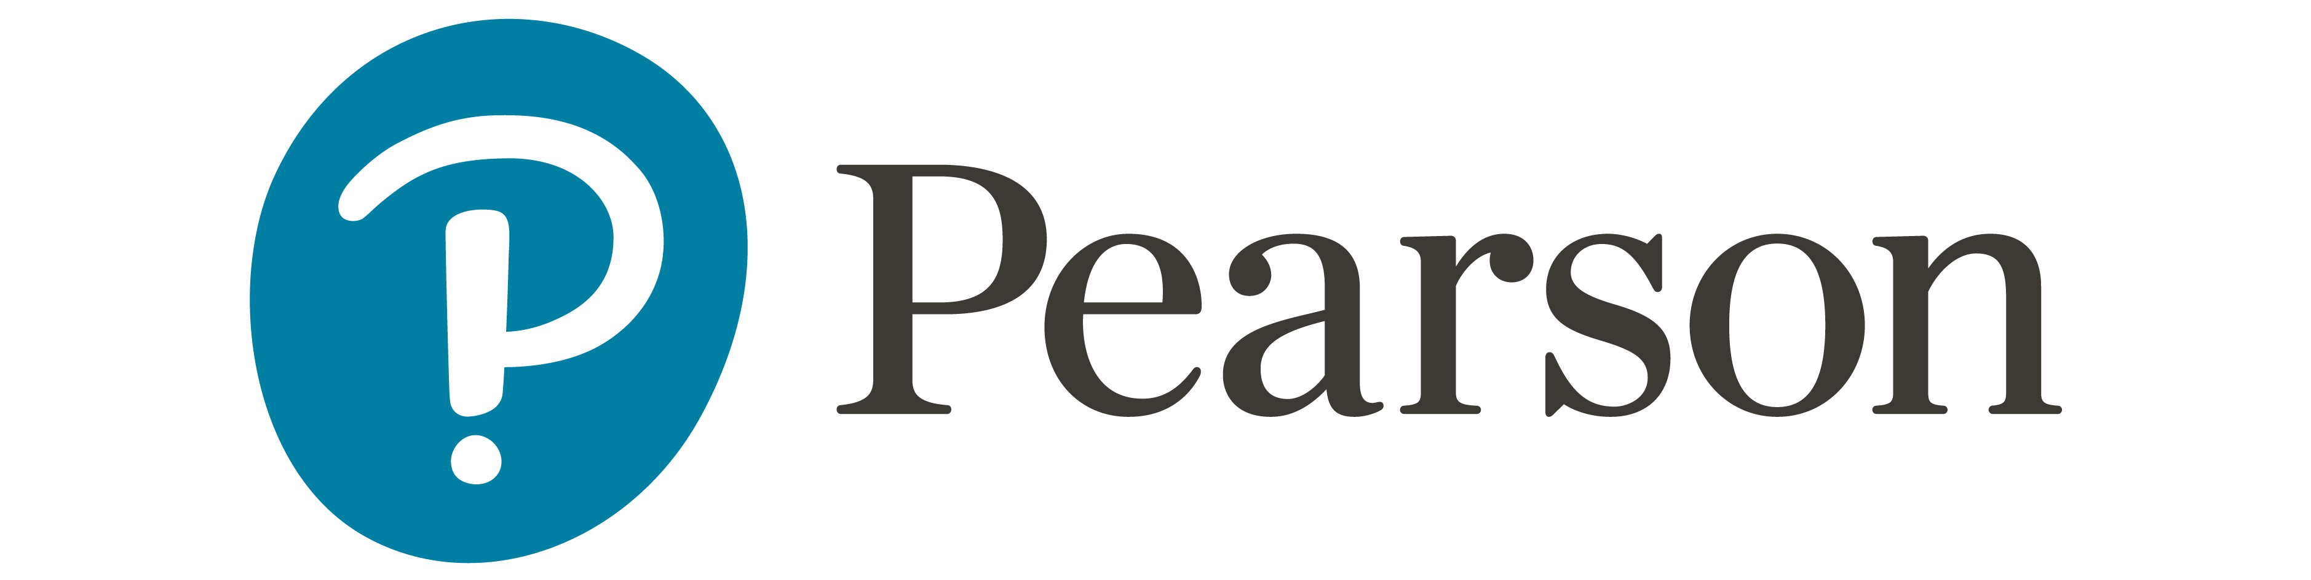
Integrated Advertising, Promotion, and Marketing Communications
Ninth Edition
Chapter 4
The I M C Planning Process
Copyright © 2022, 2018, 2016 Pearson Education, Inc. All Rights Reserved
Notes:
If this PowerPoint presentation contains mathematical equations, you may need to check that your computer has the following installed:
1) MathType Plugin
2) Math Player (free versions available)
3) NVDA Reader (free versions available)

Slide 2
Chapter Objectives (1 of 2)
4.1 What makes marketing research critical to the I M C planning process?
4.2 What categories do companies use to identify consumer target markets or market segments?
4.3 What categories do organizations use to identify business-to-business market segments?
4.4 How do the various approaches to positioning influence the I M C planning process?
Notes:
These are the objectives for Chapter 4.

Slide 3
Chapter Objectives (2 of 2)
4.5 How do the marketing communications objectives interact with the other elements of an I M C planning process?
4.6 How are communications budgets established?
4.7 What are the features of an international I M C planning program?
Notes:
These are additional objectives for Chapter 4.

Slide 4
Chapter Overview
The I M C planning process
Communications research
Target markets
Positioning strategies
Communications objectives
Communications budgeting
International I M C planning
Notes:
The IMC planning process involves a number of steps and decisions. Planning begins with research, decisions about target markets, market segmentation, and positioning. Once these factors are investigated and decisions made, then communications objectives can be created. A budget is then appropriated. Finally, planners must consider the process of planning an international IMC program.

Slide 5
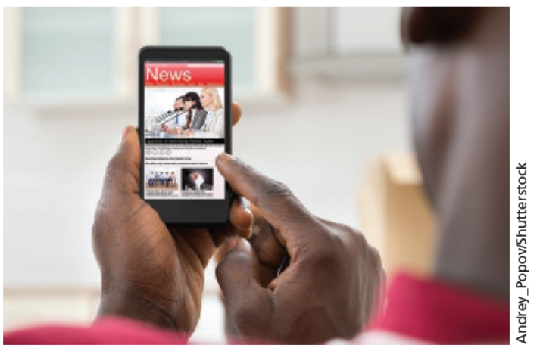
Co-Marketing and I M C Planning
Joining to sell separate but related products
Examples:
T-Mobile and Netflix
Capitol One and Hotels.com
All planners must address every step in the process
Notes:
As shown in the chapter-opening scenario, more and more companies are joining forces in co-marketing programs. Here, two companies join to sell separate but related products. Examples include T-Mobile and Netflix in the “T-Mobile ONE™ with Netflix On Us” program and the “Capital One Venture Rewards/Hotels .com 10x” partnership.

Slide 6
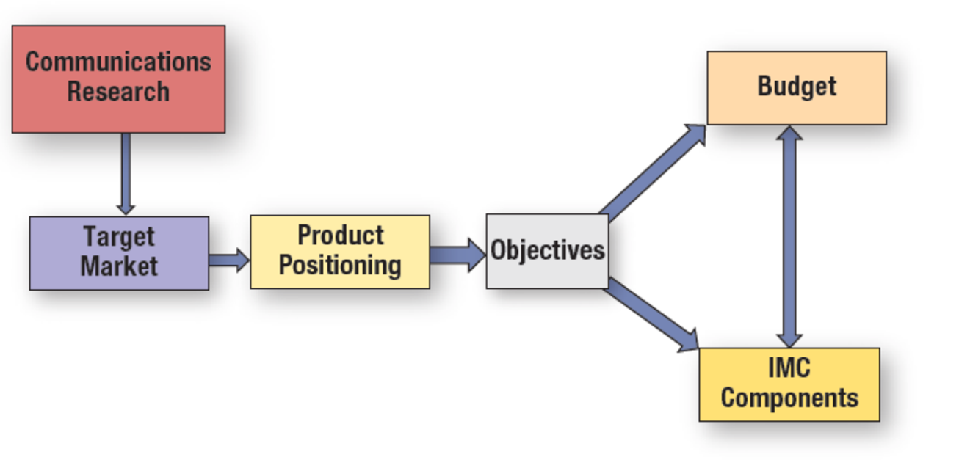
Figure 4.1: The I M C Planning Process
Notes:
The IMC planning process begins with communications research. From this research, decisions about the target market and product positioning can be made. These are joint decisions because one decision affects the other. Next, communication objectives are formulated. From the objectives come the budget and a selection of the appropriate IMC components. Again, it is a mutual decision because the budget impacts which IMC components can be used and the selection of the IMC components affects the budget.
The diagram is structured as follows. Communications research flows to the target market. The target market flows to product positioning which flows to objectives. The objectives flow to both budget and I M C components. I M C components flow reciprocally to budget.

Slide 7
Communications Research
Product-specific research
Desirable features
Key selling points
Consumer-oriented research
Context of product use
Anthropological approach
Sociological analysis
Psychological motives
Target-market research
Identifies recipients of communications campaign
Notes:
The first step in IMC planning is conducting research. If an advertising agency is used, then it is the responsibility of the agency to conduct this research so they understand the customer. What are the key benefits customers derive from the product? Consumers buy benefits, not attributes, so it is important to think in those terms, i.e. what does this product do for customers; how does it help them? Product-specific research involves identifying the key selling points of a product and the desirable features. To develop an advertising campaign, the creative staff should understand the product. Customer-oriented research focuses on the users of the product and how, when, and why the product is used. Researchers can use approaches based in anthropology, sociology, and psychology. A common method used by agencies for customer-oriented research is the focus group. Target-market research utilizes the information gathered through product and customer research to determine the best target market for the brand, product, or particular campaign.

Slide 8
Tests to Determine Viability of Market Segment
Individuals or businesses within the segment are homogeneous
Market segment is:
different from the population as a whole and distinct from other market segments
large enough to be financially viable to target with a marketing campaign
reachable through some type of media or marketing communications channel
Notes:
To be a viable market segment, it must meet four criteria. First, the individuals or businesses within the segment should be homogeneous; that is, they should be alike. Second, the market segment must differ from the general population and also be different than other market segments. Third, the market segment has to be large enough to be financially viable to support a marketing campaign. While some market segments meet the first two criteria, they are too small to support a different campaign. Based on the last criteria, the market segment must be reachable through some type of media or marketing communications channel.

Slide 9

Figure 4.2: Methods of Segmenting Consumer Markets
Demographics
Psychographics
Generations
Geographic
Geodemographics
Benefits
Usage
Notes:
Consumer markets can be segmented, or divided, along a number of dimensions. The most common is demographics because it is the easiest. Other methods used include psychographics, generations, geographic, geodemographics, benefits, and usage. This Piccadilly advertisement might have resulted from a focus group indicating that people prefer locally made food products.

Slide 10
Segments Based on Demographics: Gender
Different genders have different purchasing habits
Not all people conform to one gender role
Non-gender-based marketing shapes the campaign
Many product campaigns still target men or women
Notes:
Gender is a common demographic segmentation variable because there are significant differences between males and females and because it is easy to identify each market segment. Men and women purchase different products. They also use the same products, but in different ways. Marketers have recently been thinking beyond male and female gender roles to recognize that not all individuals conform to one gender role. An increasing number of individuals self-identify as non-binary or non-gender conforming. This will shape the creative direction of the campaign.

Slide 11
Segments Based on Demographics: Age
Targeting specific age groups
Can combine with other demographic variables
Children an attractive but controversial market
Marketing push continues through teen years
Notes:
Age is another demographic variable that is easy to use for segmentation. Obviously, there is a huge difference in the products children use versus the products adults use. Age segmentation often works well when combined with another demographic variable. For example, older women may be targets for certain types of vitamins and medical products, including those combatting osteoporosis. Young working women with children are more likely to notice advertisements for conveniences, including ready-made foods and snacks, and automotive oil and lube facilities.

Slide 12
Questions to Consider (1 of 2)
How old are your own parents?
How would you describe their lifestage?
Is it typical or hard to categorize?
What kinds of products or services might appeal to your parents based on their age and lifestage?
Notes:
Here, it is useful to ask the class for as many examples as possible. The idea is to get students to see how people in certain age groups do not fit neatly into predetermined categories.

Slide 13
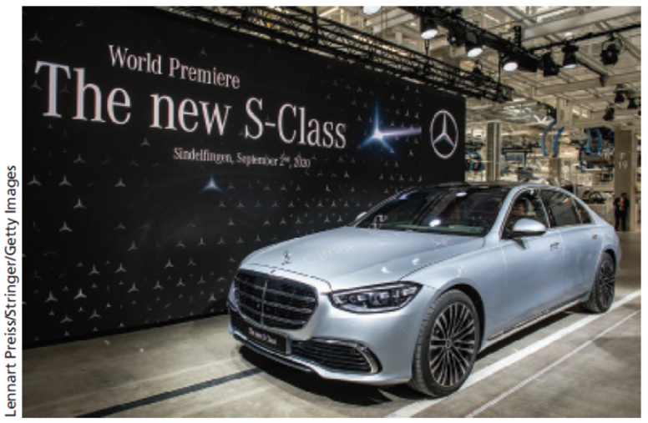
Income
Family income closely related to education
Lower income = spending on necessities
Higher income = spending on luxuries
Notes:
Other demographic segmentation variables include education and income. Each can be used alone, or combined with other demographic variables to create smaller, more homogeneous segments. For example, the “exhausted affluent” bridge the gap between the haves and the have nots. They desire style and quality, but not something overly fancy. In this advertisement, Mercedes-Benz seeks to attract customers able to buy high-end sundry items as well as those who purchase luxury products.

Slide 14

Ethnicity
Buying power = $2.5 trillion
Significant part of identity
Need to understand ethnic groups
Translations are insufficient
Holistic approach needed
Notes:
Ethnicity is an important demographic variable since minorities control $2.5 trillion in buying power. For many, ethnicity is a significant part of their identity. It is important to create advertising that demonstrates an understanding of each ethnic group. Translations of English ads are not sufficient. In recent years, advertising agencies have moved to a “holistic” approach. Rather than creating separate campaigns, they are designing a single campaign that incorporates insights from various ethnic groups.

Slide 15
Psychographics
Used to describe consumers
A I O measures:
Activities
Interests
Opinions
Combined with demographic information
Notes:
Demographics are relatively easy to identify, but they do not fully explain consumer purchase behavior. Psychographics refer to an individual’s activities, interests, and opinions. They help marketers to understand why consumers buy what they buy. Psychographics are often combined with demographic profiles to provide a much richer description of a target segment.

Slide 16
The V A L S Typology
Innovators – successful, sophisticated – upscale products
Thinkers – educated, conservative, practical – durability, value
Achievers – goal-oriented, conservative, career, and family
Experiencers – young, enthusiastic, impulsive, fashion, social
Believers – conservative, conventional, traditional
Strivers – trendy, fun-loving, peers important
Makers – self-sufficient, respect authority, not materialistic
Survivors – safety, security, focus on needs, price
Notes:
A well-known measurement of psychographics is the VALS typology. Consumers are divided into 8 different segments based on their AIO measures (activities, interests, and opinions). This type of information helps marketers design more effective communication. For instance, reaching achievers requires ads that stress careers, families, goals, and a conservative lifestyle. On the other hand, reaching experiencers requires ads that convey youthfulness, enthusiasm, impulsiveness, fashion, and social acceptance.

Slide 17

Segmentation by Geographic Area
Geo-targeting: marketing in a geographic area or region
Retailers use:
Smartphones with G P S devices
Digital ads
Notes:
Sending messages to individuals in specific regions is geo-targeting. Used by retailers. Smartphones with GPS technology allow for targeted ads based on location. As shown here, restaurants can use geo-targeting to reach nearby consumers.

Slide 18
Geodemographic Segmentation
Combines
Demographic census data
Geographic information
Psychographic information
PRIZM
66 market segments in United States
ZIP codes identify relatively uniform neighborhoods
Consumers like neighborhoods of similar people
Notes:
Geodemographic segmentation combines demographic information, geographic information, and psychographic information. Geodemographic segmentation is beneficial for national firms conducting direct mail campaigns and for retailers in targeting customers in a geographic area around the store. The most well-known geodemographic segmentation system is PRIZM. It consists of 66 different market segments. For every zip code in the United States, PRIZM identifies the market segments that reside there.

Slide 19

Benefit Segmentation
The Fitness Industry
Winners
Dieters
Self-improvers
Notes:
Benefit segmentation focuses on the advantages consumers receive from a product rather than the characteristics of the consumer. An excellent example of benefit segmentation is the fitness industry. People exercise for different reasons. The three most common benefit segments are winners, dieters, and self-improvers. The winners exercise because they like to exercise. It is a way of life for them. The dieters join a fitness center to lose weight, or maintain their weight. Self-improvers are there primarily because a physician told them to be there. They have experienced a medical problem and realize they must exercise to regain body functions or maintain their health.

Slide 20
Usage Segmentation
Usage or purchase history
Create clusters
Target specific clusters
Create marketing programs for each cluster
Measure growth and migration
Notes:
Usage segmentation focuses on how consumers use a product or on their purchase history. Marketers can create clusters of heavy users, light users, or any other category of users. By dividing the market in terms of usage, companies can target a specific cluster creating a unique marketing approach. The message to a light user of a product will certainly be different than a heavy user of a product. One of the goals of targeting light or average users is to move them up into a higher group in terms of usage.

Slide 21
Business-to-Business Market Segmentation
Group similar organizations into meaningful clusters
Create marketing messages specifically for them
Provide businesses with better service
Notes:
Another set of target markets results from identifying business-to-business segments. Here, business segmentation efforts group similar organizations into meaningful
clusters in order to create marketing messages specifically for them and to provide them with better service.

Slide 22

Figure 4.5: Methods of Segmenting Business-to-Business Markets
Industry (N A I C S code)
Size of business
Geographic location
Product usage
Customer value
Notes:
Segmentation in business-to-business markets can be based on industry, size of businesses, geographic location, product usage, or customer value. Because most businesses have records of their business customers, segmentation is often easier than with consumers, at least in identifying customers. NAICS codes are one of the most popular methods of segmentation because the federal government has developed the code and there are lists of businesses within each code. Segmentation based on size is necessary when a firm wants to focus on small firms, medium-size firms, or even large firms. Industries often locate together, e.g., computers in the Silicon Valley in California. How firms use a product can be a method of segmentation and the value of customers. In this photo, we can see how Applied Microbiology used geographic targeting to reach dairy farmers.

Slide 23
Product Positioning
The perception created in the consumer’s mind regarding the nature of the company and its products relative to the competition
Created by factors such as product quality, price, distribution, image
Notes:
Product positioning is the perception in consumers’ minds of the nature of a company and its products relative to competitors. It is important to recognize the two major points – in consumers’ minds and relative to the competition. Positioning is created by factors such as product quality, price, distribution, image, and other factors. Companies need to consider carefully where they are positioned in the market place and then develop ads to reinforce that image or move consumers to the desired image.

Slide 24

Figure 4.6: Product Positioning Approaches
Attributes
Competitors
Use or application
Price-quality relationship
Product user
Product class
Cultural symbol
Notes:
Effective positioning can be accomplished in seven different ways. Positioning by product attributes involves promoting a unique attribute that is superior or different from the competition. Using competitors to establish a position can be accomplished by contrasting the company’s brand against competing brands. Use or application involves creating a memorable set of uses for a product, or applications that allow it to stand out. Price-quality positioning can occur in two ways – by emphasizing value (low price) or by emphasizing high quality, with little mention of the higher price. The product user approach emphasizes who uses the product. Positioning can be based on the product class, such as beverages, breakfast foods, or sports cars. The last approach is cultural symbol, which strives to connect the brand to some cultural symbol that is recognized and known by consumers.

Slide 25
Questions to Consider (2 of 2)
In the Weyerhaeuser ad from the previous slide, who is the target market?
Which product positioning approach is the company using?
Does this ad appeal to you? Why or why not?

Slide 26
Other Elements of Positioning
Position never completely fixed
Changing conditions can shift brand standing
International positioning vitally important
Notes:
Product positioning is never fixed because consumers and society change. The same holds true for business products. In the international arena, product positioning is very challenging, but important. However, the position that is used in one country may not be appropriate for another country.

Slide 27
Marketing Communication Objectives
Quality communications objectives required
Tie into organization’s:
Context
Target markets
Positioning approaches
Budgeting
Guide creative efforts to design advertising messages

Slide 28
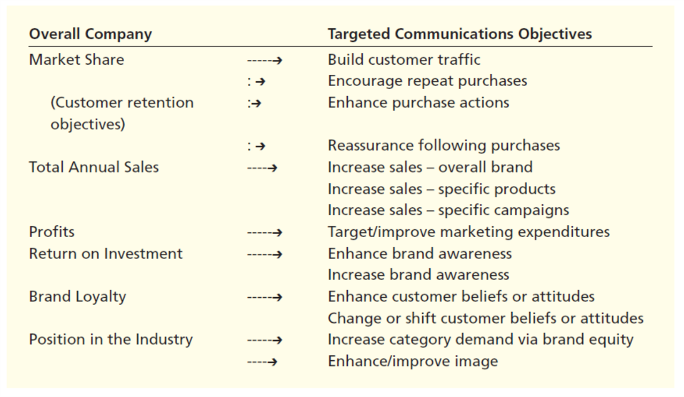
Figure 4.7: Levels of I M C Objectives
Notes:
As shown here, company leaders derive more specific communications objectives from overall marketing objectives. Then, an individual communications plan emphasizes the specific objective. A communications plan for an individual brand may emphasize one or more objectives.
The lists and the objectives are as follows.
Overall company
Targeted communication objectives
Market Share
Build customer traffic
Encourage repeat purchases
Customer retention
Objectives
Enhance purchase actions
Reassurance following purchases
Total Annual Sales
Increase sales, overall brand
Increase sales, specific products
Increase sales, specific campaigns
Profits
Target or improve marketing expenditures
Return on Investment
Enhance brand awareness
Increase brand awareness
Brand Loyalty
Enhance customer beliefs or attitudes
Change or shift customer beliefs or attitudes
Position in the Industry
Increase category demand via brand equity
Enhance or improve image

Slide 29
Types of Budgets (1 of 3)
Percentage of Sales
Sales of current year, or next year
Simple
Tends to work in the opposite direction
Does not meet special needs
Meet the competition
Seeks to prevent market share loss
Highly competitive markets
Dollars may not be spent efficiently
Notes:
The percentage of sales method sets the communication budget as a certain percent of this year’s sales or next year’s sales forecast. It is simple to use, which makes it a popular choice. However, it works in the opposite direction of what may be needed. When sales increase, so does the budget. When sales decline, the budget is reduced. It should be just the reverse. It also does not allow for special needs that may rise. Meet the competition sets a budget approximately equal to competitors. This approach is used in highly competitive markets where you have to spend what the competition does to keep your brand in front of consumers. Spending the same as competitors does not guarantee success.

Slide 30
Types of Budgets (2 of 3)
What we can afford
Set after all other items budgeted
Do not view marketing as important
Objective and task
Budgets determined by objectives
Best method of budgeting
Used by 50% of firms
Notes:
The “what we can afford” approach sets the communications budget after all of the other budges are set. Normally, with this approach, management does not see the importance of communications. The objective and task method sets the budget based on what it will cost to accomplish the communication and marketing objectives that have been established. Most marketers see this as the best method of budgeting. It is now being used by about half of all firms.

Slide 31
Types of Budgets (3 of 3)
Payout planning
Ratio—advertising to sales or market share
Larger percent at product launch
Lower percent when brand established
Based on threshold effect
Quantitative models
Computer simulations
Develop models based on historical data
Notes:
Payout planning involves setting a budget based on a ratio to sales or market share. This method usually results in spending more money early in the process and then reducing the budget after the brand is established. Quantitative models use historical data to determine the relationship between sales and marketing and then budgets are set accordingly.

Slide 32
I M C Components
More than traditional advertising
Trade promotions
Consumer promotions
Retailer promotions
Media advertising
Notes:
The last decision (in conjunction with the budget) is the selection of IMC components. Marketing communications consists of much more than traditional advertising. In fact, advertising expenditures may not make up the major portion of a marketing communications budget. Then, there is the actual spending on media. Some companies will also have to consider business-to-business spending. It is not an easy task to determine which components will be the most effective. Not only is the budget a factor, but also the objectives.

Slide 33
International Implications
Globally integrated marketing communications (G I M C) programs vital for international firms
Tailor messages to fit country’s language and culture
Brand names, marketing ideas, ad campaigns do not always translate correctly
Essential to understand the international market
Notes:
In international marketing, planners try to make sure the company’s products and marketing messages will be understood in the region. When needed, the message can be tailored to an individual area. The goal is to create a borderless marketing plan that uses the same basic marketing approach for all of a company’s markets. Another key to a successful GIMC involves developing local partnerships.

Slide 34
Figure 4.9: Successful Globally Integrated Marketing Communication Tactics
Understand the international market
Create a borderless marketing plan
Think globally but act locally
Local partnerships
Communication segmentation strategies
Market communications analysis
Solid communications objectives
Notes:
Successful globally integrated marketing communications require paying attention to a number of factors. The company must understand the international market and cultures where it will be selling products. A borderless marketing plan works best, but in developing this type of plan, firms must allow individual countries to modify the marketing plan. The idea is to think globally, but act locally. Seeking local partnerships can be very advantageous, especially in developing communication segmentation strategies and conducting a market communication analysis. With this information, solid communication objectives can be established.

